Slide 1
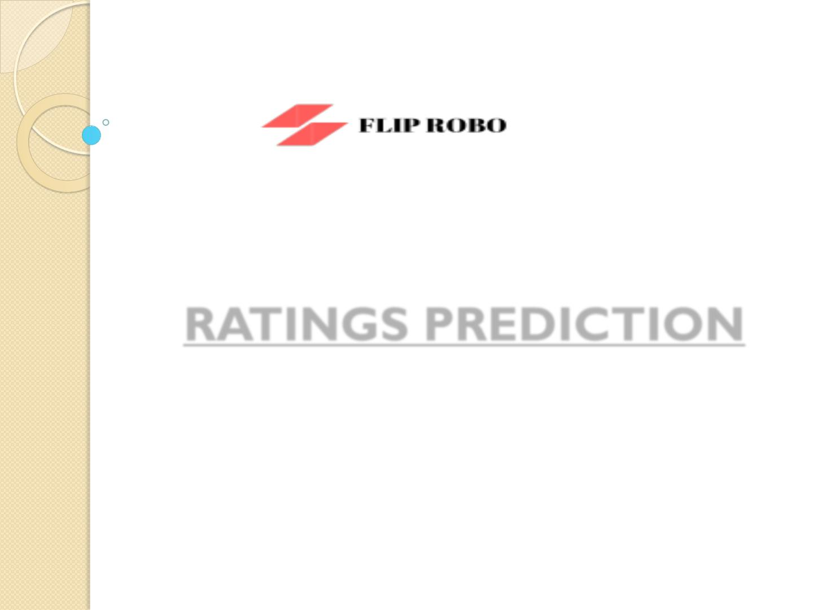
RATINGS PREDICTION
Submitted by:
NARA LOHITH

Slide 2
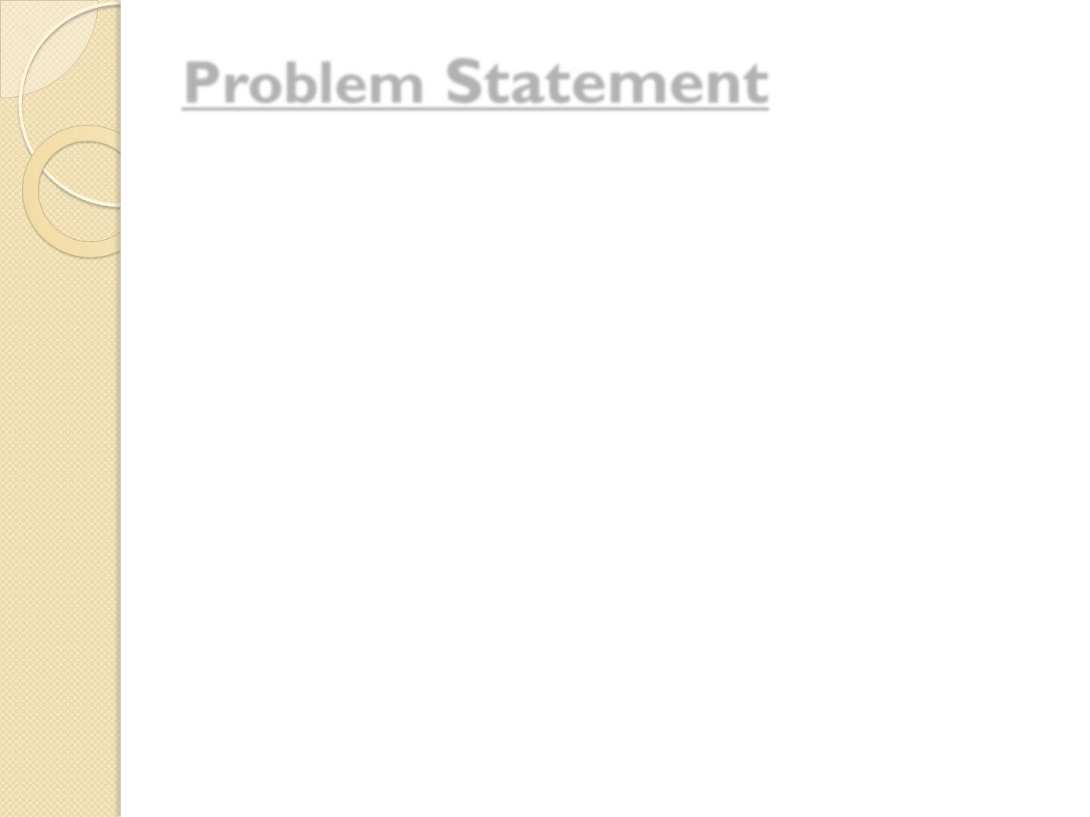
Problem Statement
• We have a client who has a website where people write
different reviews for technical products. Now they are
adding a new feature to their website i.e. the reviewer will
have to add stars(rating) as well with the review. The
rating is out 5 stars and it only has 5 options available 1
star, 2 stars, 3 stars, 4 stars, 5 stars.
• Now they want to predict ratings for the reviews which
were written in the past and they don’t have a rating. So,
we have to build an application which can predict the
rating by seeing the review.
• Ratings Prediction: We have to predict ratings of all
the products based on the reviews given by customers
which will be pre-processed and trained.

Slide 3

Analytical Problem Framing
Data Collection Phase
 We have to scrape the reviews of different laptops, Phones,
Headphones, smart watches, Professional Cameras,
Printers, monitors, Home theater, router from different e-
commerce websites. Basically, we need these columns:
 1) reviews of the product.
 2) rating of the product i.e., 1,2,3,4,5

Slide 4
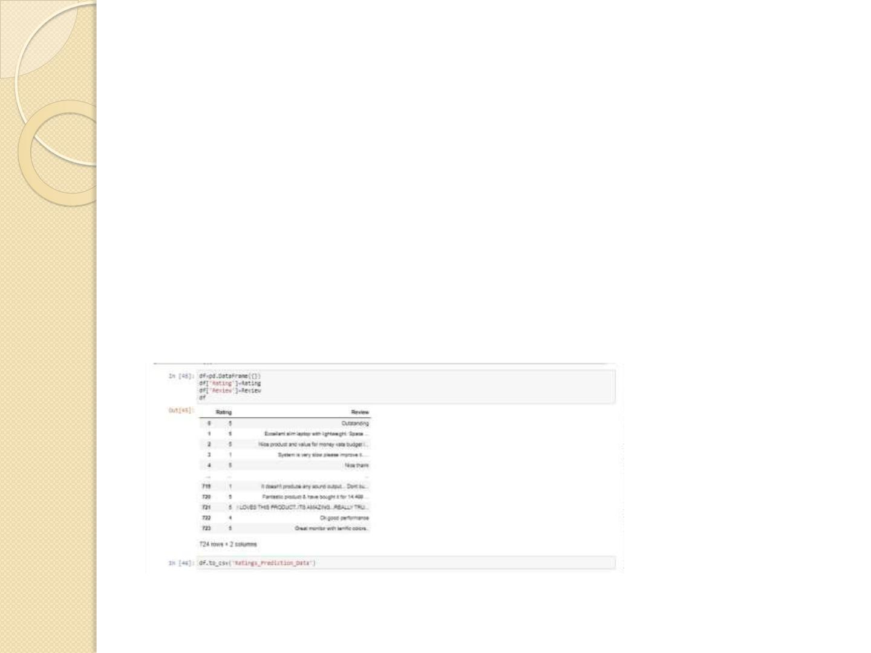
 Firstly we have collected data i.e, we did web scraping of a
website Flipcart and passed collected all the reviews and
ratings of products that we wanted to scrape such as :
['laptops', 'Phones', 'Headphones', 'smart watches',
'Professional Cameras', 'Printers', 'monitors', 'Home
theater', 'router'].
 Finally we created a dataframe and stored the ratings and
reviews in it and also saved it in csv format. Sample data is
as shown below:

Slide 5
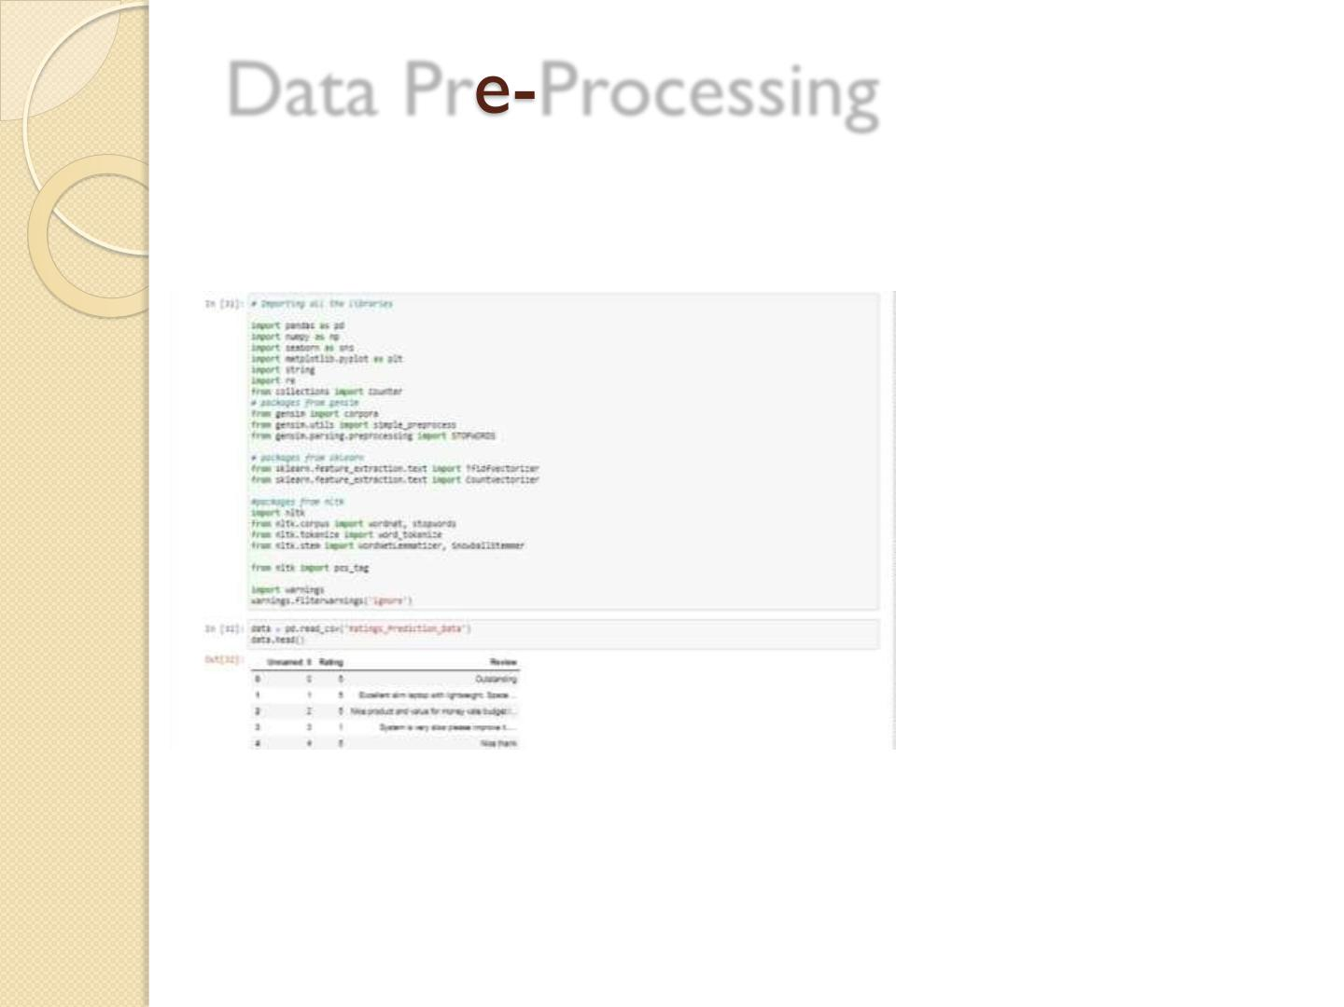
Data Pr Processing
 The data is that we saved in csv format we imported it
using pandas and to further proceed with the pre-
processing steps.
 Then we further checked more about data using info(),
shapes using .shape, value counts using value_counts(), null
values using .isnull. .sum().sum(), and further visualize it
through heatmap as follows:

Slide 6
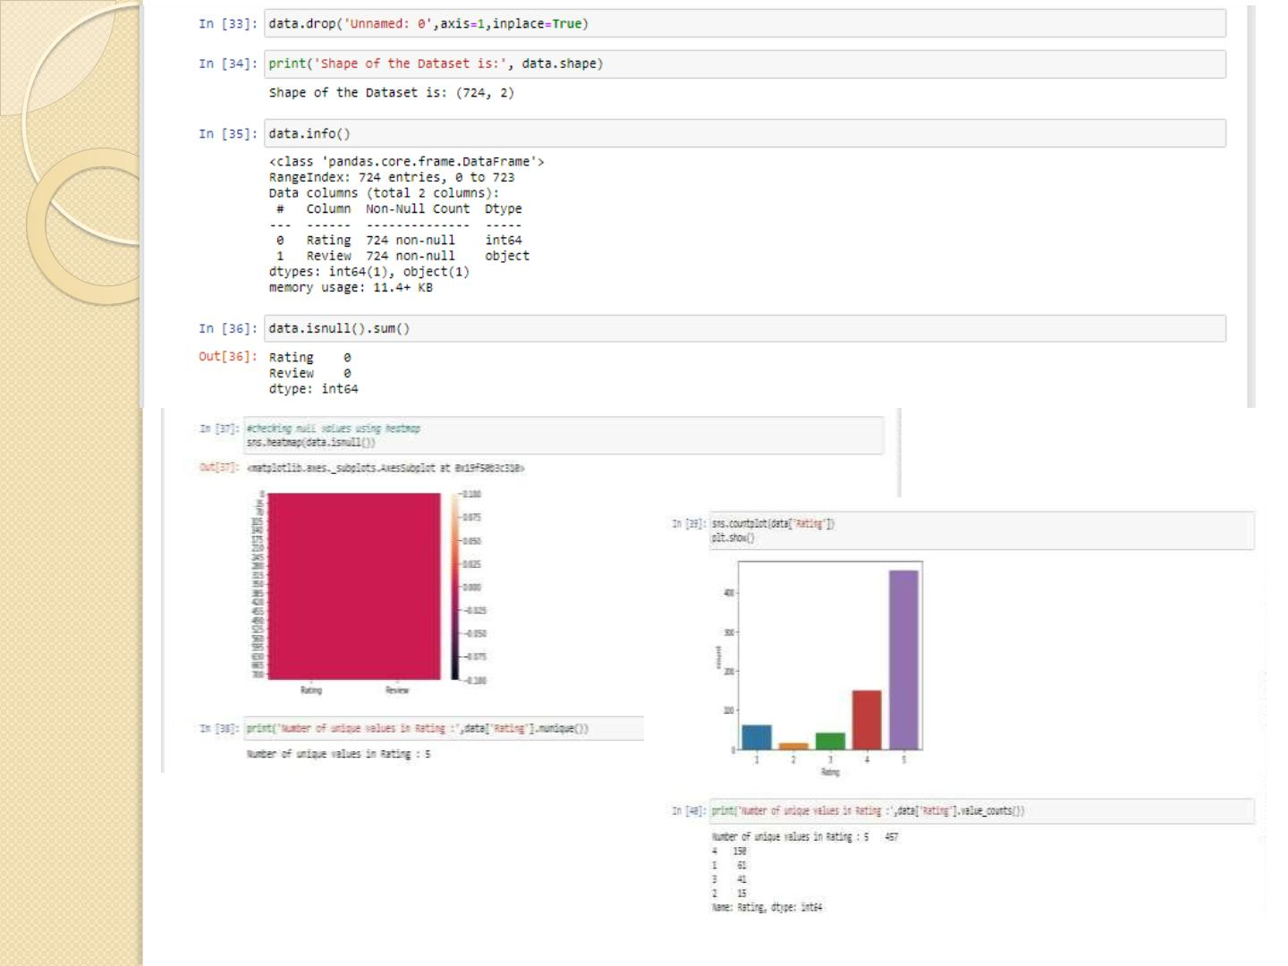
From this we can observe that 63%
data has rating 5.

Slide 7
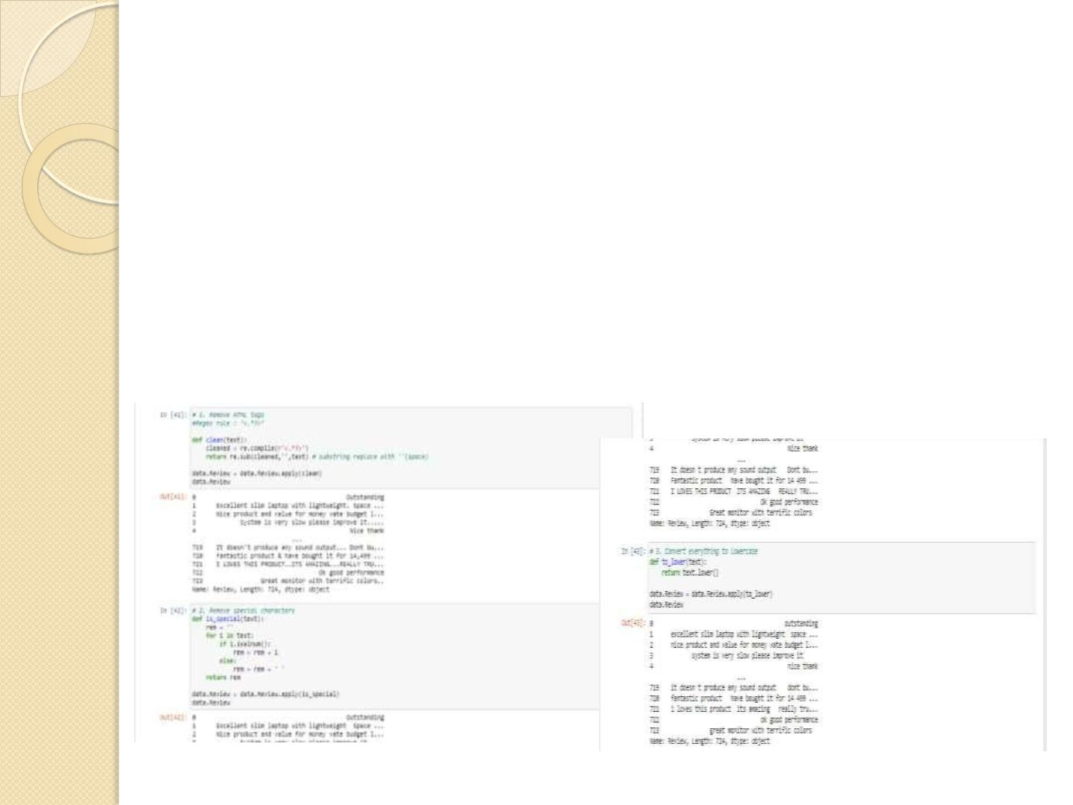
Further we have performed data cleaning such as removing
html tags, special characters, converting everything to
lowercase, replace email addresses with 'email', URLs with
'webaddress', money symbols with 'moneysymb', 10 digit
phone numbers (formats include paranthesis, spaces, no
spaces, dashes) with 'phonenumber', numbers with 'numbr',
whitespace between terms with a single space, removing
leading and trailing whitespace and punctuations. We also
removed Stopwords.

Slide 8
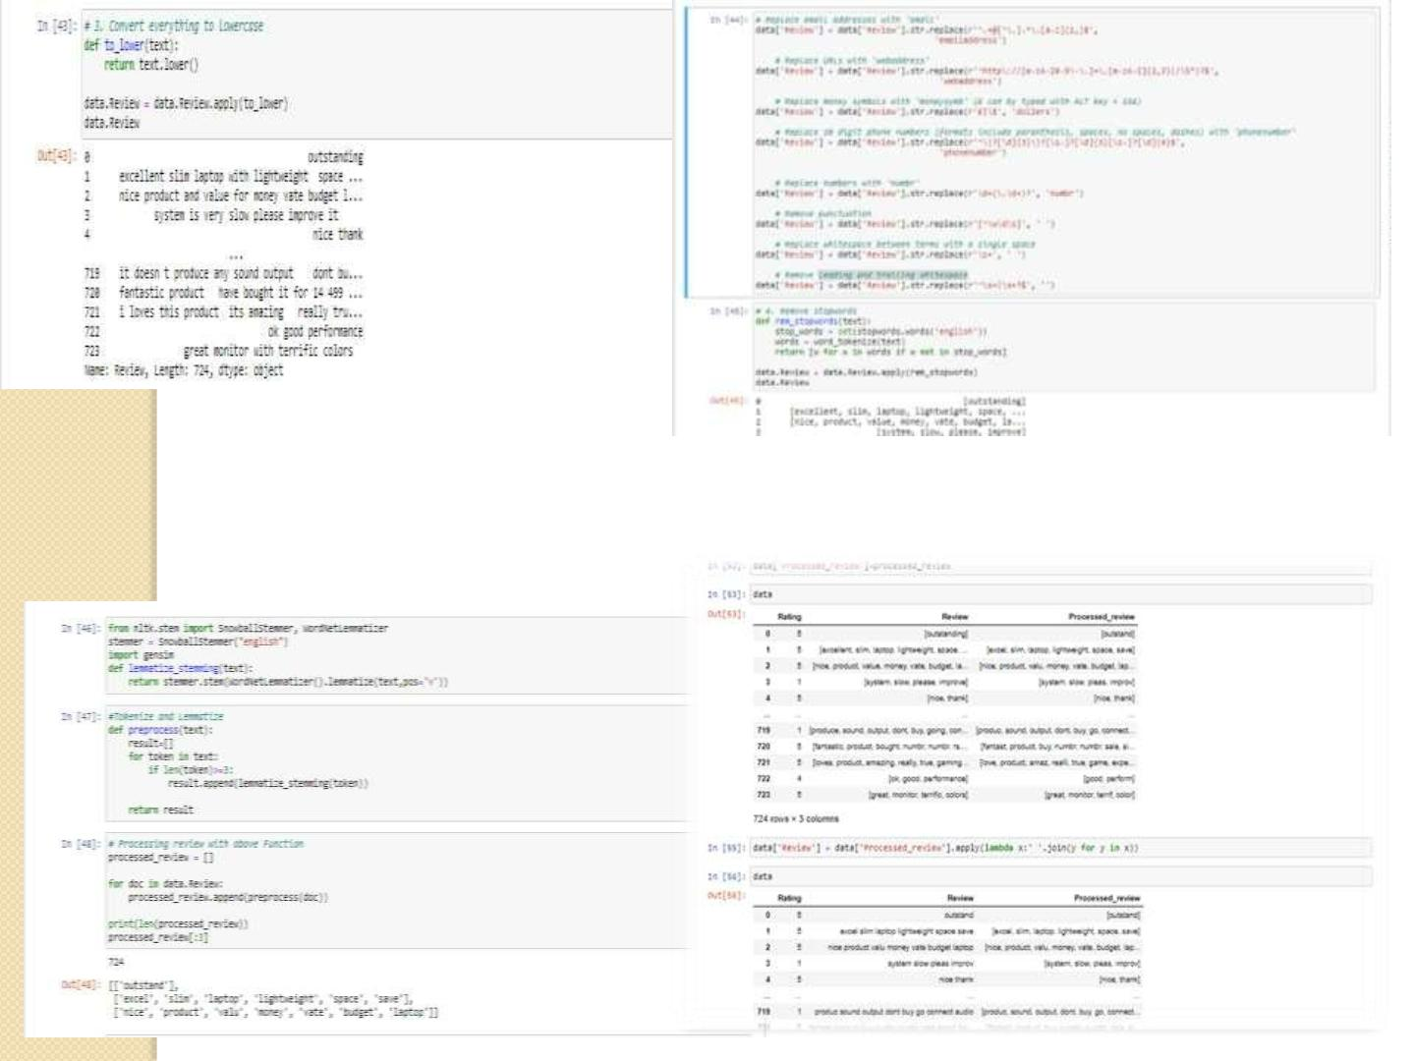
 Then we performed stemming using Snowball Stemmer and WordNetLemmatizer.
Then we further pre-process the text and save the final processed data in
processed_review.

Slide 9
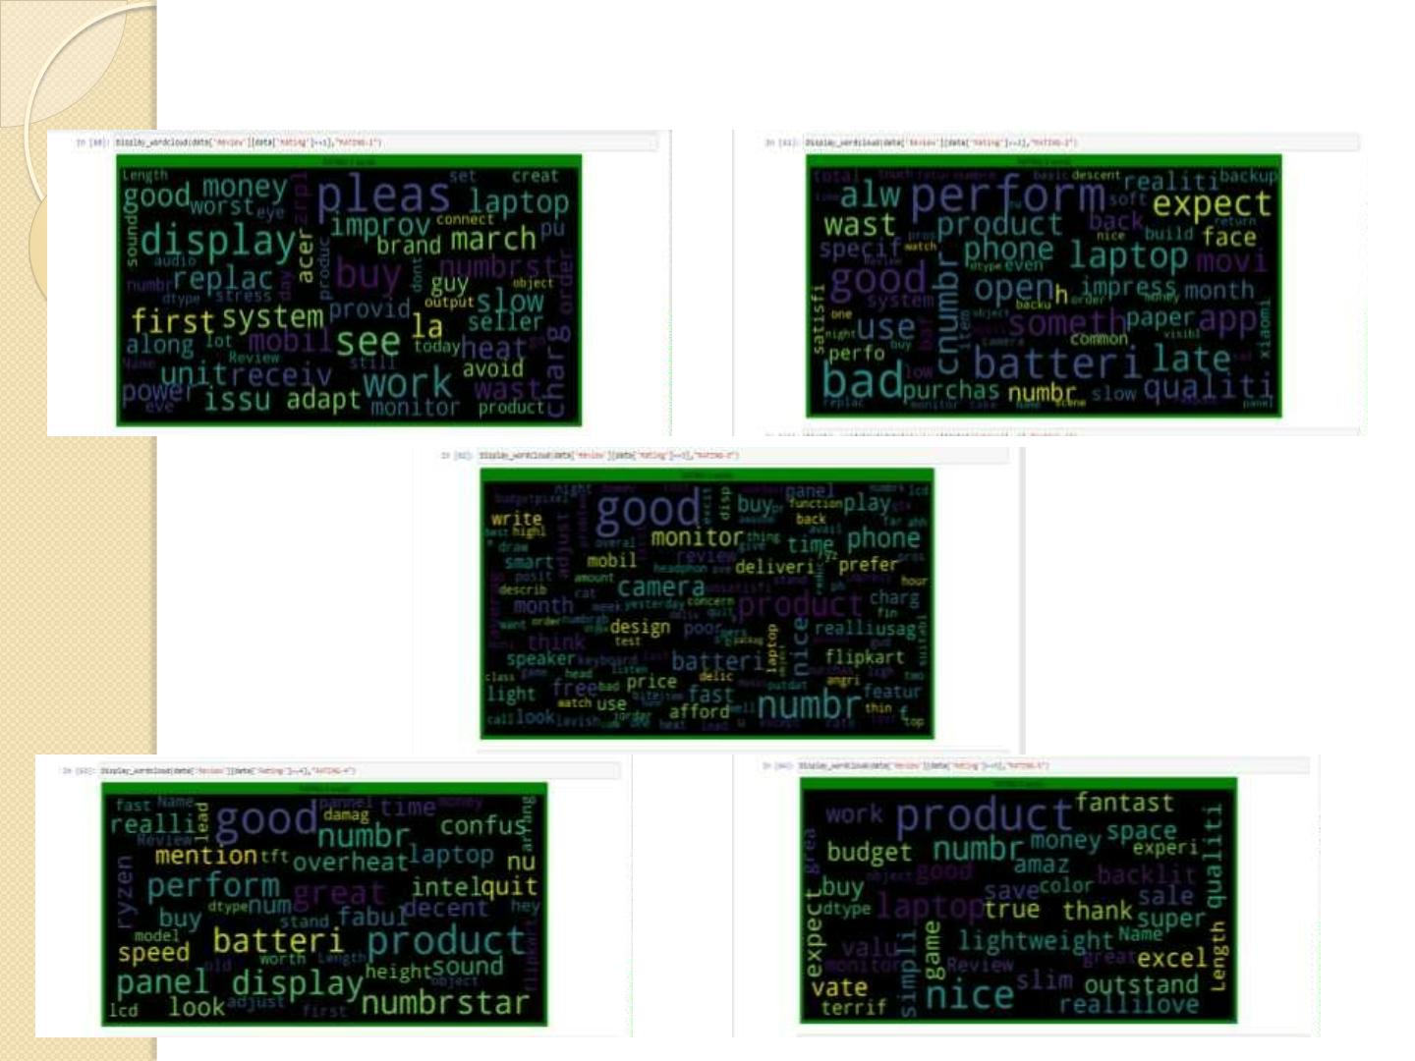
 To get sense of loud words in Review corresponding to each rating i., 1, 2, 3, 4 and
5 we have used wordcloud and visualized it as follows:

Slide 10
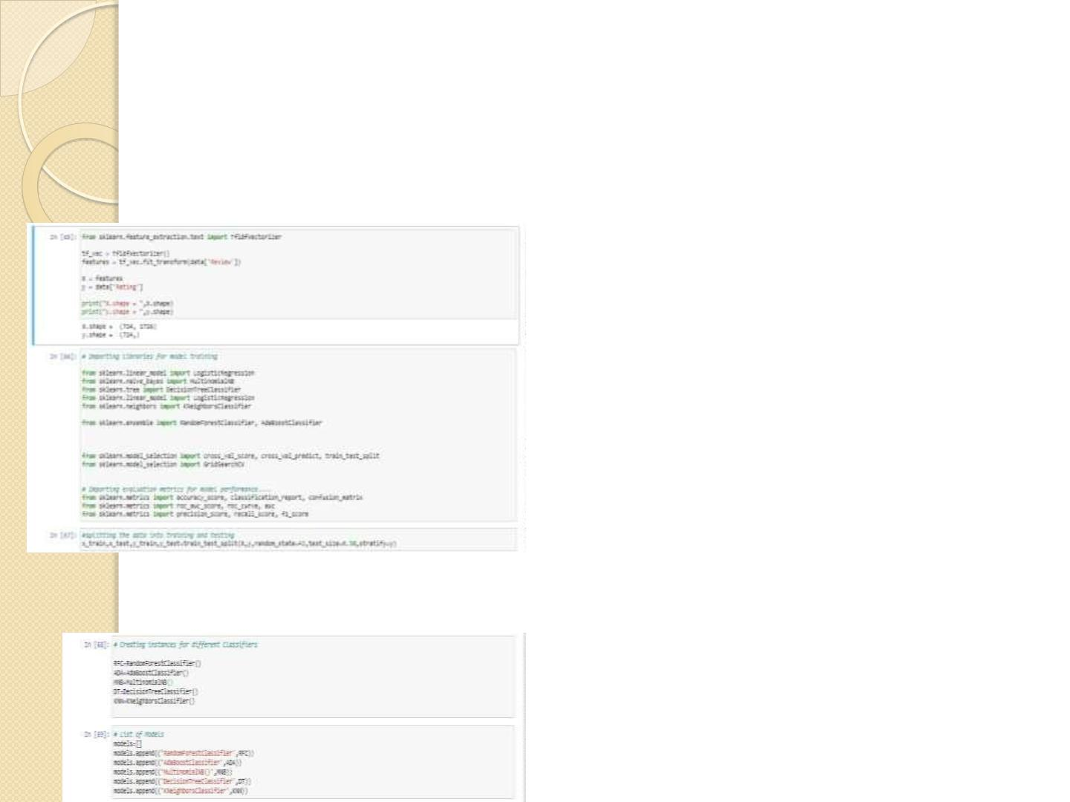
Model/s Development and Evaluation
 Review column have been converted to tokens using TFidfVectorizer. Then using
train_test_split we split the data into training and testing dataset.
• We have used following algorithms such as: RandomForestClassifier,AdaBoostClassifier,
MultinomialNB,DecisionTreeClassifier and KNeighborsClassifier.

Slide 11
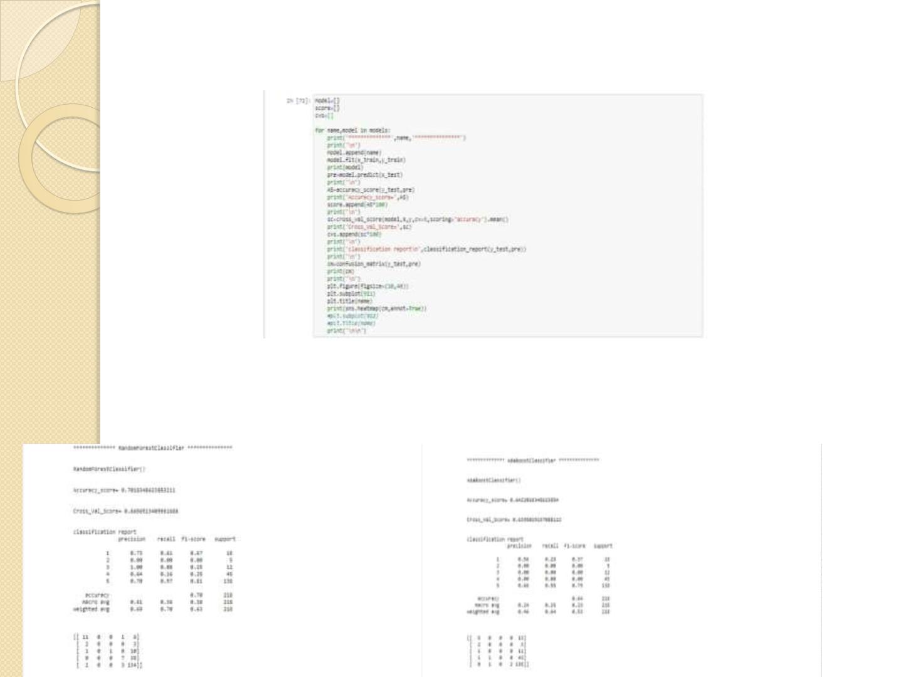
 We have formed a loop where all the algorithms will be used one by one and
their corresponding accuracy_score, cross_val_score and classification report
will be evaluated.
 Key metrics used for finalising the model was accuracy_score, cross_val_score.
Since in case of RandomForestClassifier it was giving us maximum score among all
other models and it's performing well. It's cross_val_score is also satisfactory and
it shows that our model is neither underfitting/overfitting.

Slide 12
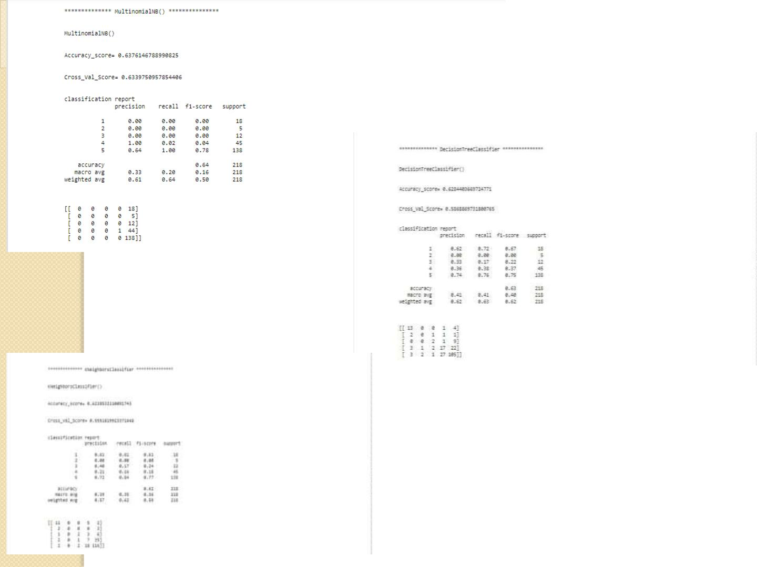

Slide 13
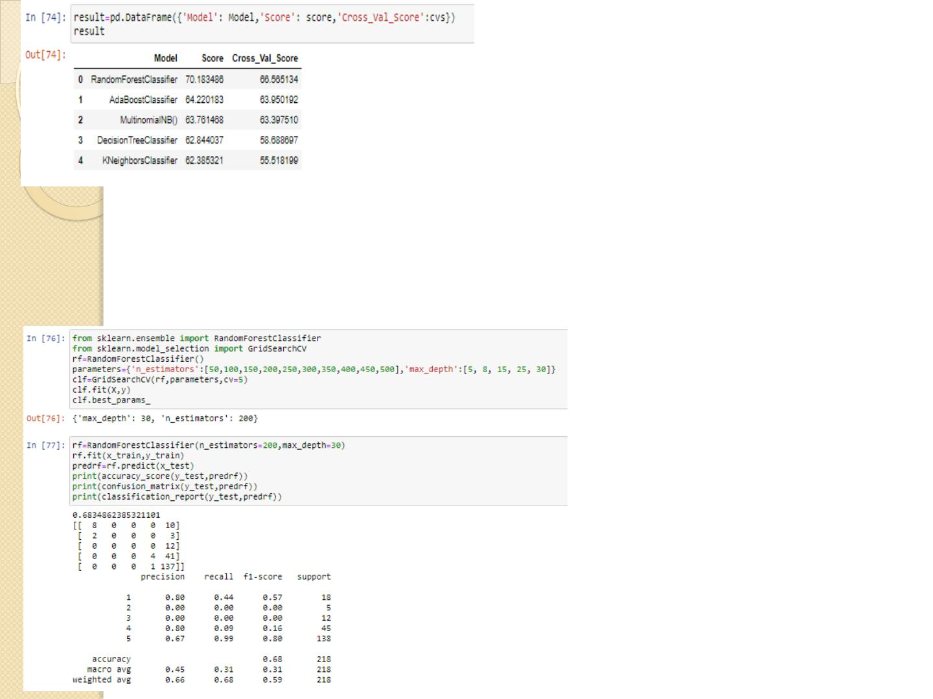
 Since RandomForestClassifier was giving us maximum score we
applied hyper parameter tuning on it to further improve the result
using GridSearchCV.

Slide 14
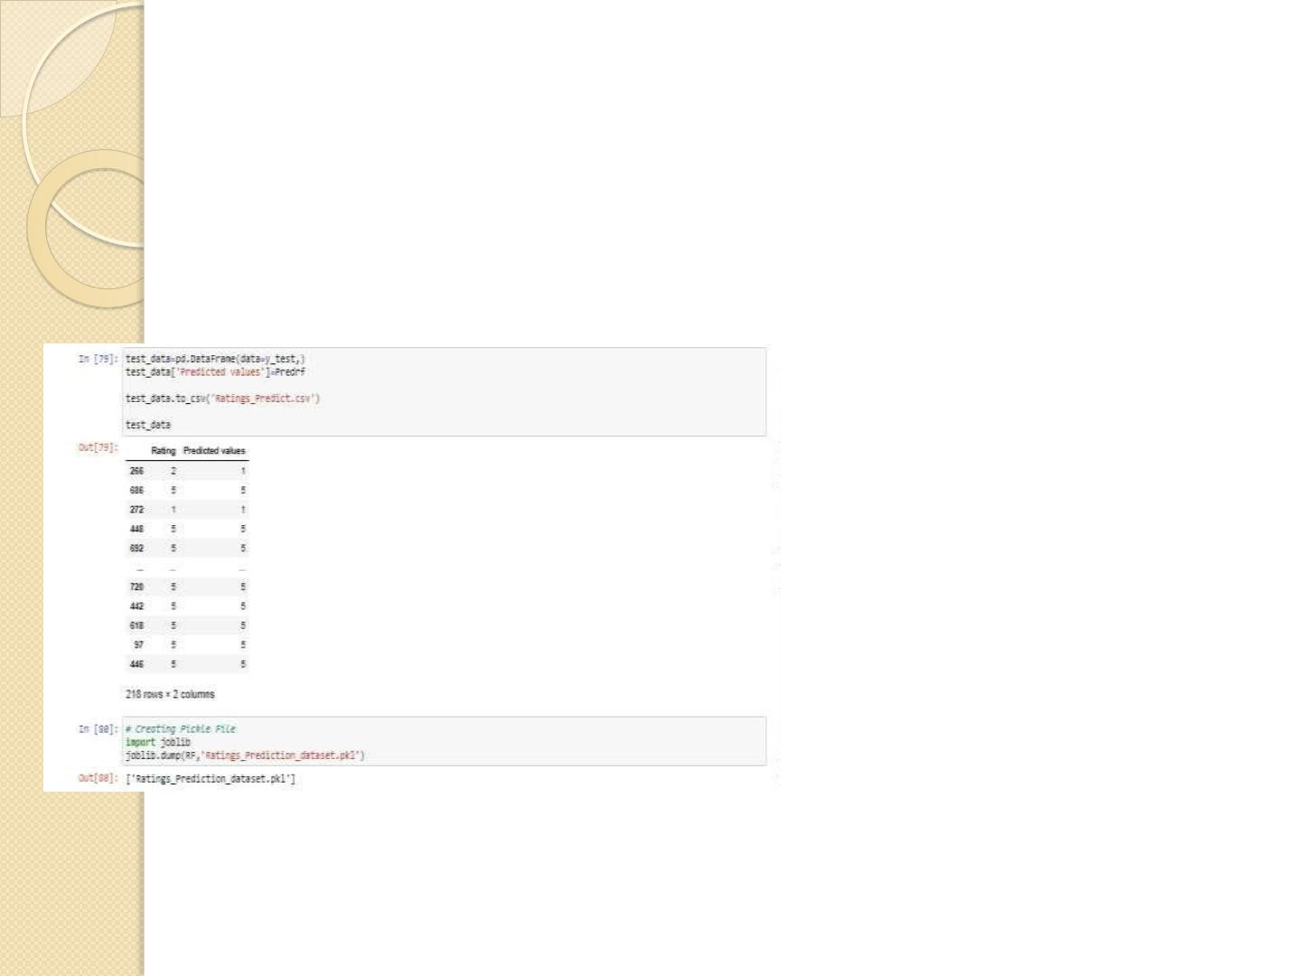
 Since it didn’t show any improvement in result even after
hyperparameter tuning. Hence, we will be choosing the
RandomForestClassifier Model with default values that we got
earlier.
 We will further use that model to predict our test data set as
follows:

Slide 15
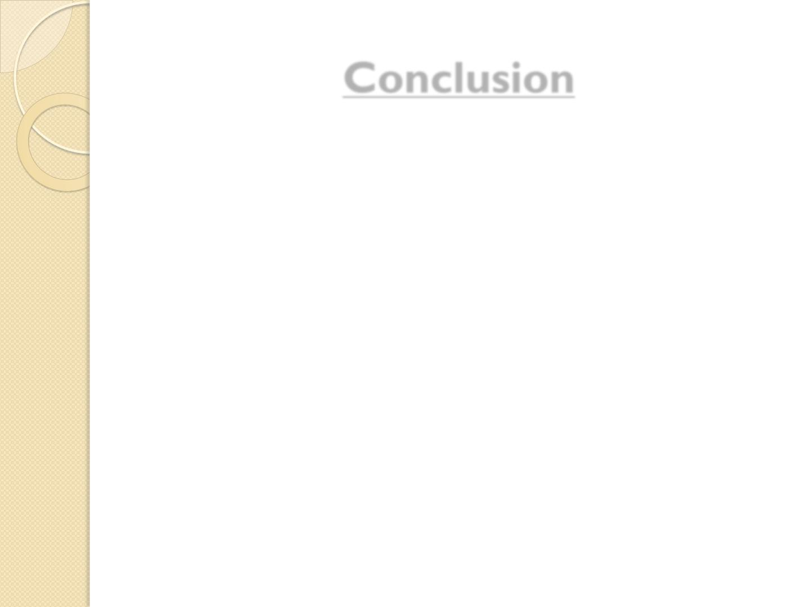
Conclusion
 We have got the accuracy score of 70% using
RandomForestClassifier. Hence, our model is working well.
 Since the data was quite imbalanced as it contained more
than 60% ratings as 5.
 We had less data.
 I have included one more additional work folder in the zip
file where I have scraped data from amazon as well. Hence
it contains data from two websites i.e., amazon and flipcart.

